Slide 1





Creating online campaigns around counter and alternative narratives
Training seminar Civil Society Empowerment Programme

Slide 2
Objective
Today, we will introduce the GAMMMA model. This approach will help you to build an effective online campaigning strategy around your alternative or counter narrative
You will experience how to use social media as part of your (online) communication campaign with your target audience
You will learn how to amplify your positive message and engage your target audience
Notes:
Following the GAMMMA sections, participants can make use of a template to take notes during the day
The objective is to help empower CSOs to carry out effective campaigns and to shorten their learning curve by sharing experiences of earlier campaigns.

Slide 3
Working principles
Limited theory – lots of practice
Learning by doing
Learning from both success and failure
Learning from each other
You are the expert already!
Notes:
We will follow a “from practitioners to practitioners approach, appreciating that CSOs know their local context best.
The material is therefore practical and easy to implement.
The training material can be seen as a simple way of structuring your prep work towards a successful C/A Narrative Campaign.
We will share success as well as failure; next to showcasing good practice, we will make a ‘Comms /Campaign pitfalls’ list: a list of things we know often fail

Slide 4

Civil Society Empowerment Programme
Aim: Support local civil society in countering violent extremism online
Launched by EC at 2nd EU Internet Forum, 8 December 2016
Now: Network development + training programme in EU countries
Next: Call for proposals
Partners
Support
Notes:
The training seminar has a goal in itself: to enhance the online campaigning expertise of CSOs active in the field of countering violent extremism.

Slide 5
Exchange of experience
Discuss in couples
  Your experience in communication with your target audience
  Challenges in conveying your counter/alternative narrative
  Your needs with regard to online campaigning
Notes:
10’
Introduction of participants to each other
Note. Questions are the same as those in the registration form

Slide 6
Exchange of expectations
Plenary inventory
  What would you like to learn during the seminar?
  What would you like to share?
Notes:
10’
Introduction to participants to the whole groups
List all wishes, needs, demands and ideas, experience, expectations on flipover or whiteboard

Slide 7
Six Basic Questions
G Goal
A Audience
What is your goal?
Who is your target audience?
What is your message?
Who is the messenger?
What are your media?
What is your call to action?
M Message
M Messenger
M Media
A Action
Notes:
Answers to these questions constitute the basic outline of your campaign strategy
These questions guide you through the process of preparing a successful C/A Narrative Campaign

Slide 8
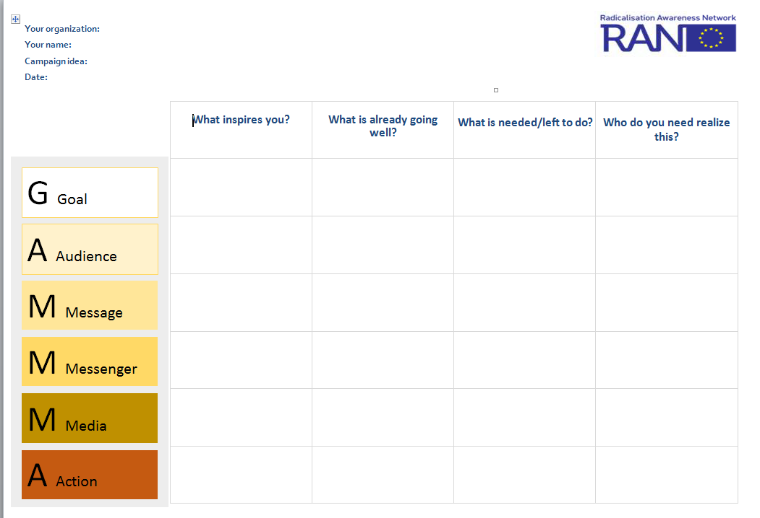

Slide 9
Today’s programme
G Goal
A Audience
09.00 Welcome
09.45 Setting the scene
10.30 Coffee
11.00 How to develop your C/A online strategy
12.30 Lunch
13.30 How online works
15.30 Tea
16.15 Capacity building
17.00 Finish
M Message
M Messenger
M Media
A Action
Notes:
Programme by topic
Setting the scene
The GAMMMA approach
Violent extremist or terrorist messages
Counter and Alternative narratives online
How to develop your C/A online strategy
Online campaigning
Communication strategies
Linking online – offline engagement
What is your goal?
Who is your target audience?
What is your message?
Who is the messenger?
Three campaign templates
How online works
From strategy to operation
Online = dynamic dialogue
How will you affect behaviour change?
Three big social media platforms
Are you on the right track?
Hate speech online: what to do?
Tools, manuals, tutorials
Capacity building
From capacity-building to call to action
SWOT Analysis
Collaboration with CSOs and marketing agencies

Slide 10
Setting the scene
09.45 – 10.30

Slide 11
Violent extremist or terrorist messages
Plenary discussion
What kind of online violent extremist or
terrorist messages do you know?
What is luring your target audience? Why?
Notes:
Note to trainer
Prevent identification bias before mismatch between trainer and trainees occur
First ask for actual experience and ideas of the participants before showing examples of alien examples
10’

Slide 12
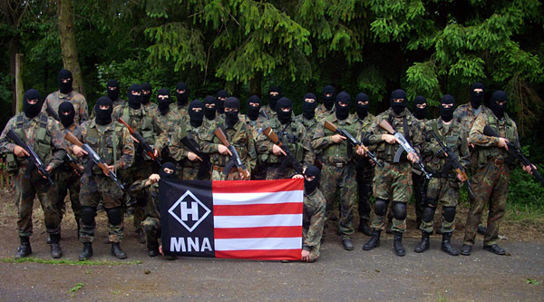
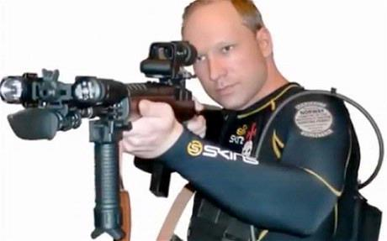

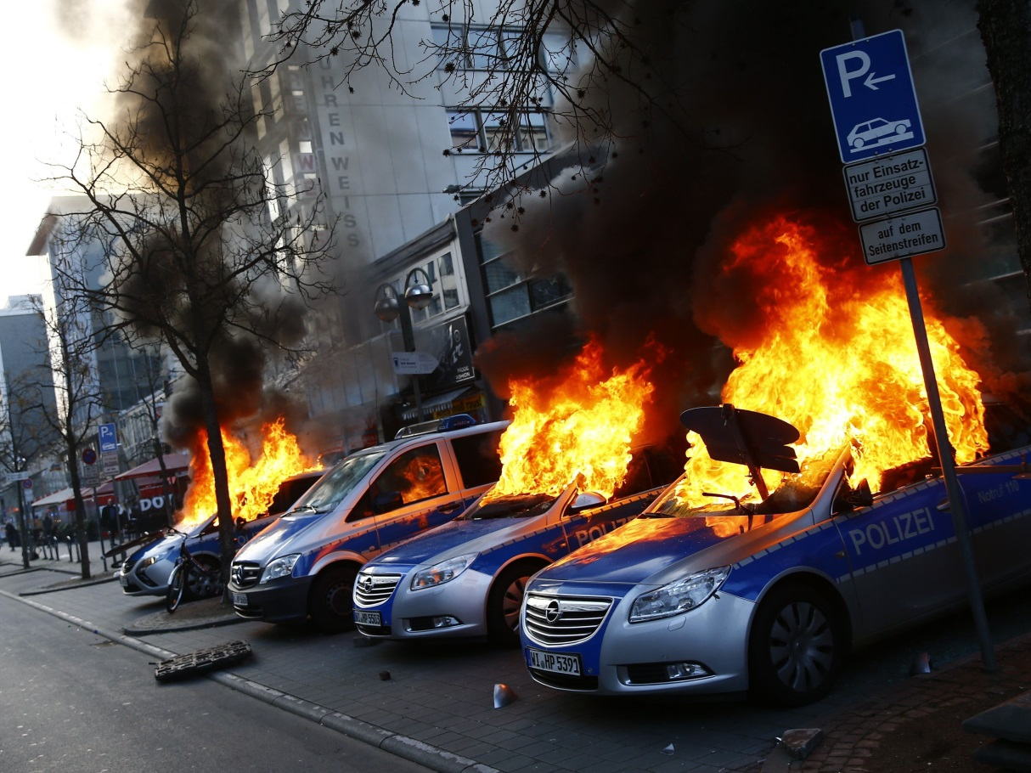
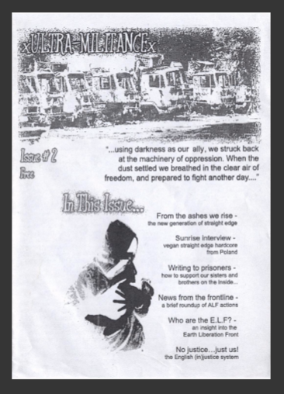


Slide 13
Definition
Violent extremism
Advocating, engaging in, preparing, or otherwise supporting ideologically motivated or justified violence to further social, economic or political objectives
Radicalisation
Growing readiness to pursue and/or support—if necessary by undemocratic means—far reaching changes in society that conflict with, or pose a threat to, the democratic order
Notes:
RAN’s approach towards effectively tackling radicalisation is summarised as the so called “RAN DNA”.
Involving and training first-line practitioners is key: these practitioners will be the first professional point of contact for individuals at risk. To be able to have a preventative approach, they need to be aware of signs of radicalisation, and know how to seek support to address these signals whilst maintaining a positive relationship with the individual.
Prevention is key: it is crucial to invest in interventions that are aimed at removing the breeding ground for radicalisation to prevent these processes or stop them as early as possible.
Multi-agency approach is key: To be able to prevent radicalisation and to safeguard individuals at risk, multi-agency cooperation is necessary to provide a consistent and reliable network. In this network, expertise and information can be shared, cases can be discussed and there can be agreement and shared ownership on the best course of action. These networks should be combinations between law enforcement, professional care organisations as well as NGOs and community representatives.
Tailor-made interventions, adapted to local circumstances, are key: each individual at risk is different, which calls for a case-by-case approach. It is important to understand the individuals’ background, grievances, motivations, fears, frustrations etc. to be able to develop a suitable intervention. Besides internal factors, external factors such as the individual’s social environment and other local circumstances need to be taken into account to provide effective support.

Slide 14
RAN vision on radicalisation
Radicalisation is a process
It is important to draw a line between ideas, even if extreme, and violent actions resulting from extreme ideas
It is important to focus on the capacity to make a well informed distinction also between different types of violence
Notes:
Radicalisation = process with multiple factors and different pathways
Youth (families, communities) are victims rather than perpetrators
Prevention is about safeguarding vulnerable people/communities
RAN’s approach towards effectively tackling radicalisation is summarised as the so called “RAN DNA”.
Involving and training first-line practitioners is key: these practitioners will be the first professional point of contact for individuals at risk. To be able to have a preventative approach, they need to be aware of signs of radicalisation, know how to seek support to address these signals whilst maintaining a positive relationship with the individual.
Prevention is key: it is crucial to invest in interventions that are aimed at removing the breeding ground for radicalisation to prevent these processes or stop them as early as possible.
Multi-agency approach is key: To be able to prevent radicalisation and to safeguard individuals at risk, multi-agency cooperation is necessary to provide a consistent and reliable network. In this network, expertise and information can be shared, cases can be discussed and there can be agreement and shared ownership on the best course of action. These networks should be combinations between law enforcement, professional care organisations as well as NGO’s and community representatives.
Tailor-made interventions, adapted to local circumstances, are key: each individual at risk is different, which calls for a case-by-case approach. It is important to understand the individuals’ background, grievances, motivations, fears, frustrations etc. to be able to develop a suitable intervention. Besides internal factors, external factors such as the individual’s social environment and other local circumstances need to be taken into account to provide effective support.

Slide 15
How do extremist groups reach out?
Many types of violent extremist narratives
Right wing extremism, religiously inspired extremism
Different violent extremist ideologies often have similar communication approaches:
  Push factors and pull factors
  Combination of emotional appeal and very rational arguments
  Head (ratio) + heart (emotion) + belly (intuition)
Notes:
Examples of Push factors
Feeding grievances - exclusion; strong sense of injustice; feeling of humiliation; rigid binary thinking; conspiracy theories; sense of victimhood
Feeding marginalisation - discrimination; limited social mobility; poor education; unemployment; criminality
Political narratives – mainly ‘West is at war with Islam’. Also the ban on theveil; Cartoon crises; Islamophobia
Claiming ideological and religious legitimacy - apocalyptic prophesy; violent interpretation of Jihad; sense that Islam is under siege and desire to protect ummah; view that West is immoral secularism
Feeding culture and identity crises - cultural marginalisation; lack of belonging to either home or parents’ society; reinforces religious solidarity with Muslims around the world

Slide 16
Discussion
1-to-1 approach?
Extremist
behaviour
Recruitment
Raising interest
At risk
Target audience?
(Very simplified model)
Notes:
Discussion in plenary
Radicalisation has various stages. At what stage does your organisation (want to) intervene?
Various forms of interaction with your target groups. What do you choose: Prevention, Alternative, Narrative or Counter speech?
Local is key. How can social media be a useful tool for intervention?

Slide 17
Can online communication be a tool for intervention?
“A lot can be achieved through recycling,
adapting and building upon
the successful campaigns of others”
Notes:
Good designers copy, Great designers steal - this is a well known adage in the creative industries
Do you have campaigns in mind that inspire you?
Now, we present a few examples of well known campaigns that might inspire you to come up with something of your own:
Not Another Brother (Quilliam Foundation – James Russell)
Netz-gegen-nazis. They did offline activism and presented it online: http://www.netz-gegen-nazis.de
These examples are merely focused on fighting polarisation instead of offering counter- or alternative narratives. They show signs of solidarity and community

Slide 18
https://youtu.be/IjIQ0ctzyZE
Example 1 #Notanotherbrother
Notes:
https://youtu.be/IjIQ0ctzyZE
Link refers to youtube video, duration 1:41’

Slide 19
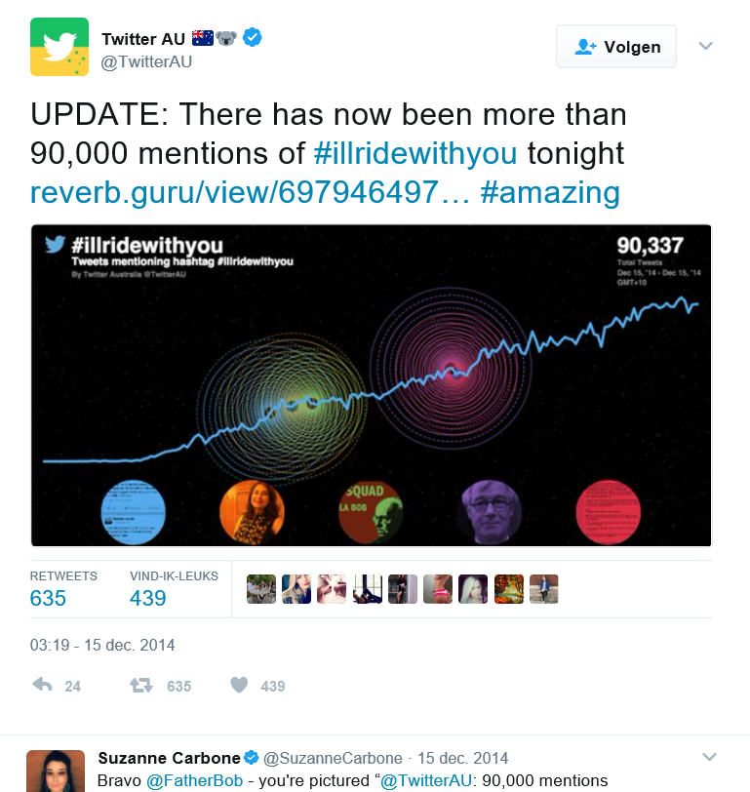
Link…
Example 2
Notes:
Note to trainer: I’ll ride with you started as an online twitter campaign immediately after racial insult event in Australia. The hashtag and its cause became adopted by a national educational programme.
December, 2014
Monday's hostage crisis in Sydney, Australia, may be over, but the circumstances surrounding the incident — in which three people, including the gunman, died and four others were injured following a 16-hour standoff — remain murky. Little is known about the motives of Man Monis, the suspect in the episode, or the details of the police operation that ended the crisis.
It was amid this prevailing uncertainty that a backlash against Australian Muslims started online. As reports spread quickly about the hostage situation — including the religious identity and nationality of the gunman, as well as the involvement of a black flag with the words of the shehada, the Muslim affirmation of faith, on it — the primary hashtag for the episode on Twitter, #SydneySiege, came to embody the occasional and predictable ugliness of the Internet. Xenophobic and anti-Muslim tweets went out and the Australian Defence League, an ultra-right-wing group, threatened confrontations in the Muslim-majority Sydney suburb of Lakemba.
Facebook
On a train, one passenger reportedly spotted a Muslim woman removing her hijab, ostensibly out of fear of being targeted. The passenger told her to put it back on and offered to walk with her in solidarity. And so began #IllRideWithYou. The hashtag went viral and is currently still trending worldwide, hours after the end of the hostage crisis.
Source: https://www.theatlantic.com/international/archive/2014/12/illridewithyou-hashtag-sydney-siege-anti-islam-australia/383765/

Slide 20

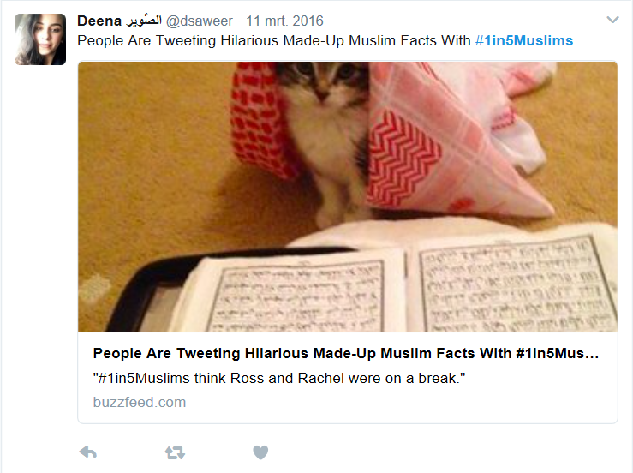
Example 3

Slide 21

Notes:
Donate the hate
Campaign in which every reported incident of hate speech is turned into a donation for refugees.
https://www.youtube.com/watch?v=ykH6peLv1wk (video removed)
http://www.hasshilft.de/index_en.html

Slide 22
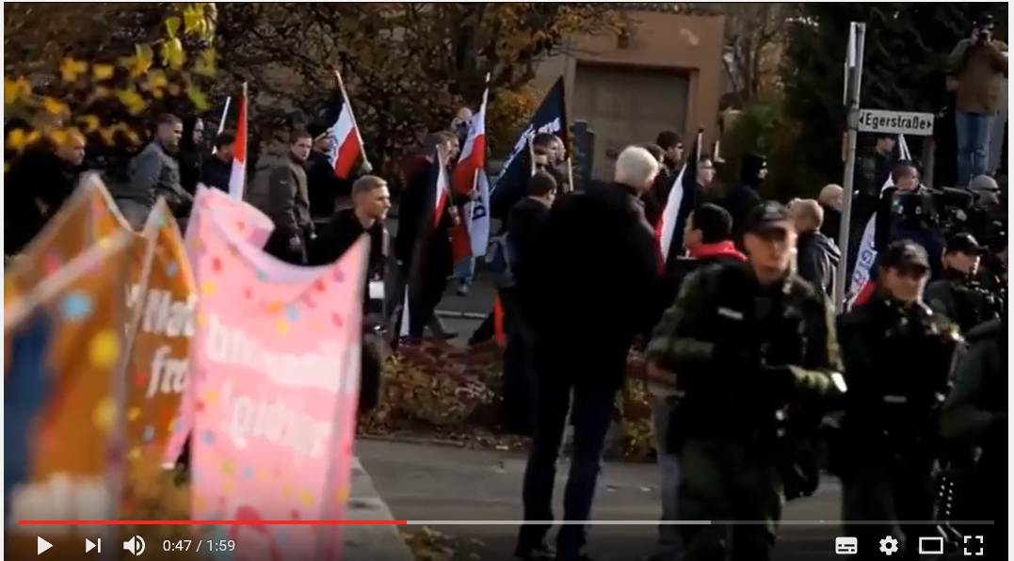
Notes:
https://www.youtube.com/watch?v=6aY2ILXeN64
Nazis against Nazis - Exit Deutschland Campaign Wunsiedel [English]
Nazis against Nazis
During a protest march of neonazis every meter they walked was sponsored by amongst others pro refugee charities.
Video: https://www.youtube.com/watch?v=KvjIYl_Nlao
Website: http://www.exit-deutschland.de/english/

Slide 23
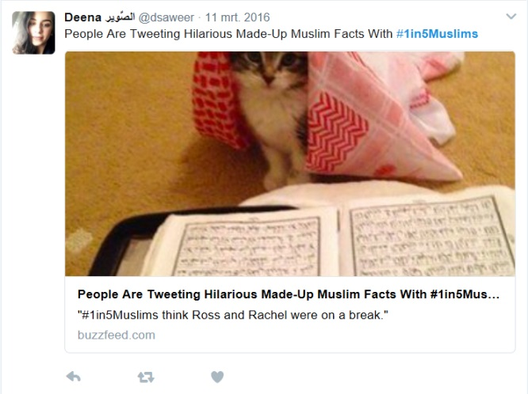

Reflection in the plenary
What did you see? What did you feel?

Slide 24
Coffee break
10.30 – 11.00

Slide 25
How to develop your online strategy
11.00 – 14.30 (including lunch break)

Slide 26
Online campaigning: why?
You enable people to have their voice heard
You educate your target audience
You build a network
Notes:
This slide and the following 3 slides define what campaigning is. Here, we also share some tips regarding the relationship between online – offline.
Internet is an open space. People will talk back to you. Both adherents and opponents will respond to your posts, tweets and videos.
Example: #Blacklivesmatter is not coordinated from 1 point.
Online campaigning is defined by Twitter as ‘joining the dots’ > people will join the conversation that you start, and will add their own opinions, experiences to it.

Slide 27
Communication strategies
Everyday
Campaigning
Reaction
Notes:
Everyday communication includes
Efforts aimed at making your organisation and activities known among your target audiences
Regular information e.g. about activity schedules
Sharing facts and figures that are of importance in your field of interest
Reports and press releases that inform the wider public about your activities and results
Annual reports et cetera
Reactive communication includes
Press releases, meetings, posts, tweets etc. that follow (immediately) after some sort of external event e.g. a terrorist attack, a provocative statement by a politician, a decision by the city council etc.
The goal is to mark your position, and/or to engage people in sharing their opinion about the event and/or fighting the effects of the event, e.g. worsening image of your target audience among the wider public.
It can be part of a wider campaign, but it can be a stand alone communication effort too.
Campaigning
A campaign is a coherent and consistent set of interventions, efforts, means and messages during a given period of time with a clear-cut objective that can be recognised both by your own staff and volunteers as well as by your target audience and/or the wider public. The objective can be framed in terms of a call-to-action. You want people to start (or stop) doing something. E.g. buy a car, vote for a candidate, apply for scholarship or subscribe to your newsletter. A campaign always has a clearly defined target audience. In a good campaign, all efforts are focused on this target group and not on third parties. However, do not become blind to the response that your campaign may create among groups other than your target audience. It might become clear that you cannot ignore these responses as they interfere with your strategy.

Slide 28

Notes:
Always, communication and campaigning strategies combine both online as well as offline efforts
Noteingang is an old example of a successful German campaign that aimed to fight violent and racist attacks in the early years of the 21st century.
Still very much before the internet became widely used.
It consisted among other things of window signs that bar keepers, shop owners and private persons could attach to their doors and windows, indicating safe spaces where people could flee to if they were attacked or threatened on the street.
Interesting is the fast pace of the spread of this campaign (despite the lack of media like Twitter or Facebook) and its simplicity and clear-cut message.

Slide 29
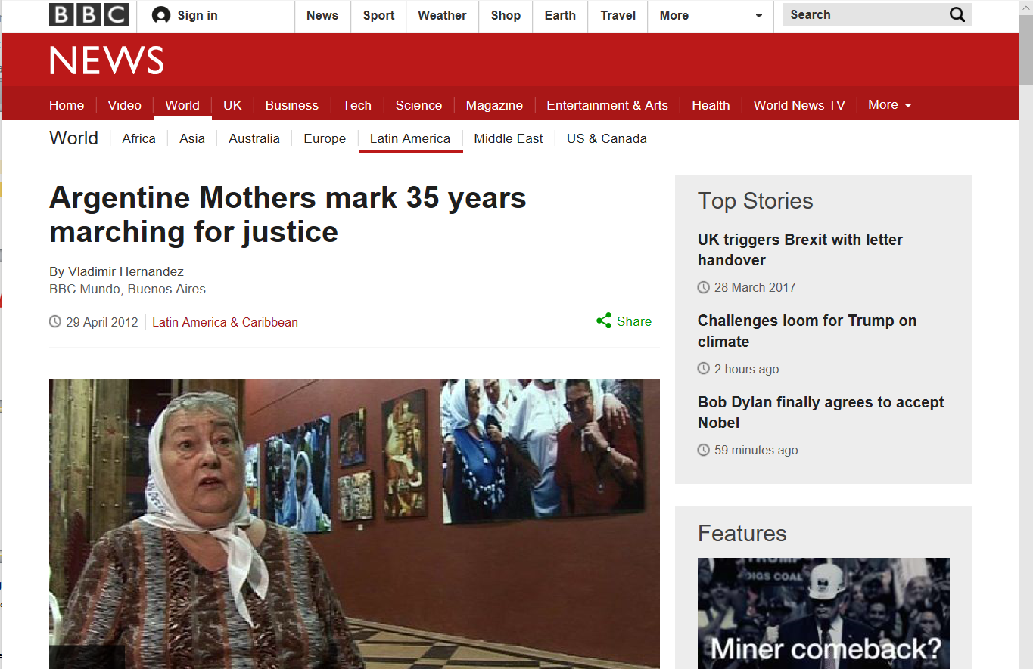
Notes:
Mothers of Plaza de Mayo (35 jaar)
http://www.bbc.com/news/world-latin-america-17847134

Slide 30
Campaign strategy
G Goal
A Audience
What is your goal?
Who is your target audience?
What is your message?
Who is your messenger?
Answering these questions will help you to build an online campaign strategy around your alternative
or counter narrative
M Message
M Messenger
M Media
A Action
Notes:
These questions guide you through the process of preparing a successful C/A Narrative Campaign strategy
They help you understand the WHY and WHAT of your campaign.
The answers help you to understand relationships between your aim, your audience and the shape and content of your message.
Simply: do you understand what you are doing? Are your actions the most effective way of realising what you have in mind considering the thoughts, opinions, values and behaviour of your target audience?

Slide 31
What is your Goal?
G Goal
A Audience
Inventory in the plenary
To give information, facts & figures?
To empower people?
To demystify seductive extremist messages?
De-radicalisation?
…?
M Message
M Messenger
M Media
A Action
Notes:
C/A narrative campaigning goals: examples
Showcase your organisation and its activities
Raise awareness for your humanitarian cause
Build online support community
Disseminate beliefs and/or political messaging
Direct counter narratives at extremist propaganda
Empower your target audience and its surroundings
Ad 3: Building an online support community, e.g. the Digital Nun: https://twitter.com/digitalnun?lang=en, http://www.benedictinenuns.org.uk/Community/Community/prayerline.php
Ad 6: Empowering CSO client groups / members to disseminate their own messaging, e.g. ‘Conscious Creators’ (Luke Newbold)
Other goals are e.g.
interactive online campaign like 'bring back our girls’ twitter hashtag campaign, but use something smaller scale and realistic for CSOs,
alternative narrative campaign around e.g. career advice / life skills, e.g. https://www.barclayslifeskills.com/ as positive forward thinking online narratives that are inclusive and therefore alternative to negative backward-thinking extremist narratives of isolationism and division from society

Slide 32
Goals: where to start?
YOUR unique capability or opportunity Why YOU?
Aim is always behaviour change
To start or adopt new behaviour
To stop doing something damaging
To prevent the adoption of a negative or harmful behaviour
To change existing behaviour
Notes:
Explain:
Online campaigning must build upon the already existing activity/image/position of your organisation.
It starts from you asking yourself why you think you are the right person/organisation to provoke change among the members of your target audience.
Why do you think they will listen to you? What makes you a credible voice? How are you seen by your target audience?
Helpful question: Are your values resonating in your target audience’s behaviour?
Refer e.g. to Circle of Influence – Circle of commitment by Covey
Source: Alicia Kearns, slide #2 Where to start?

Slide 33
Defining your goal
How to define clear objectives and indicators for success
Make it measurable
Make it small
Make it simple and concrete
Make it time-bound
Notes:
How to define clear objectives and indicators for success?
You must do this in order to monitor and measure the impact on a rolling basis. Continuous monitoring will help you with 2 things:
It will help you to understand whether you have chosen the right approach in your campaign and whether your efforts generate desired results. E.g. if you aim to mobilise 100 persons in 10 weeks, the number of newly mobilised people must grow by 10/week.
It will help you to understand what the strong points are, as well as the flaws in your campaign. This will allow you to improve and adapt your campaign constantly. E.g. if there is no response to your Facebook posts by the target audience, you might reconsider whether FB is the appropriate platform for communication with them.
As a rule, you cannot measure rise or decline of degree of radicalisation among your target audience since your organisation is not equipped to execute this type of research/survey; and since there is no direct relationship between your campaigning efforts and the change of attitude/thought/action among your target group.
However, you can measure the no. of people that contact you, your organisation.
Example: rise of x participants in your activity, volunteers in your organisation, applications for support, advice during set period of time

Slide 34
Example of smart goals
Difficult to achieve
Reduce by 30% the number of Muslim men aged 35-45 from Birmingham and Tower Hamlets travelling to Turkey/Syria/Iraq to become Foreign Terrorist Fighters by May 2017.
Realistic to achieve
In six months increase by 65% the number of 13-18 year old girls from South Thanet contacting our phoneline for advice about a friend at risk of being radicalised by right-wing violent extremist groups in order to reduce the number of individuals radicalised in our area.

Slide 35
Exercise
Individual preparation (10 mins)
Define the goal of (the current online campaign of) your organisation
Make it measurable, small, simple and concrete, time bound
Compare results in small groups of 3 persons (10 mins)
Notes:
Helpful questions
How many persons from the target audience will be reached?
What is a call-to-action?

Slide 36
Who is your target audience?
G Goal
A Audience
How do they receive and transfer information?
What is their online environment?
What context are they living in?
What language do they use?
What is their cognition?
M Message
M Messenger
M Media
A Action
Notes:
Hyper target your audience: specify, specify, specify
Youngsters at risk parents, family, friends, teachers …?
Male, female? Cultural background?
Degree of social inclusion? Income? Education?
Employed/unemployed?
Social environment: protective or permissive?
New to radical thought or radicalised?
Where do they live?
Religiously inspired or politically inspired?
Open for exchange of opinions and ideas?
See following slides for more questions regarding the characteristics of your target audience.
See also the paper “How to Identify Target Audience” by EFD. This will be sent to participants.

Slide 37
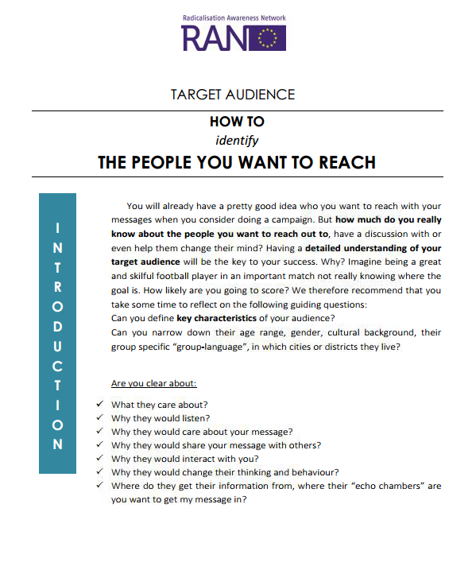

Slide 38
Notes:
Do you know your audience well?
Ask yourself the right questions
NB. See also previous and next slides for examples of questions
The scheme has been based upon experience with the development of commercial marketing strategies.
From presentation by Alicia Kearns:
How do they receive and transfer information?
What context are they living in?
What language do they use?
What is their cognition?

Slide 39

Do you know your target audience well?
Who are you?
Exercise
Split up into 3 or 4 groups
If your target audience is 1 person…
Make a drawing
Discuss his/her characteristics
with your group
Ask each other questions that help
to make the image more detailed
20 mins
?
Notes:
Hand-out of drawing paper
Questions can be helpful to make the drawing more detailed:
What is the average age of your target audience?
What do you talk about with your target audience?
What is a key topic of conversation among people from your target audience?
How does the social environment of your target audience look?
How do they receive and transfer information?
What context are they living in?
What language do they use?
What is their cognition?
Differentiate to various target groups:
Youngsters, parents, social surroundings
Migrants, low/high income, low/high education, employed/unemployed
In- or excluded from society
Religiously inspired or politically inspired
Social environment: protective or permissive
Interested in radical thought, experienced in radical thought
Passive target group for propaganda or active in extremist narrative
Stage of radical thought and radical behaviour: open for exchange of opinions and ideas

Slide 40
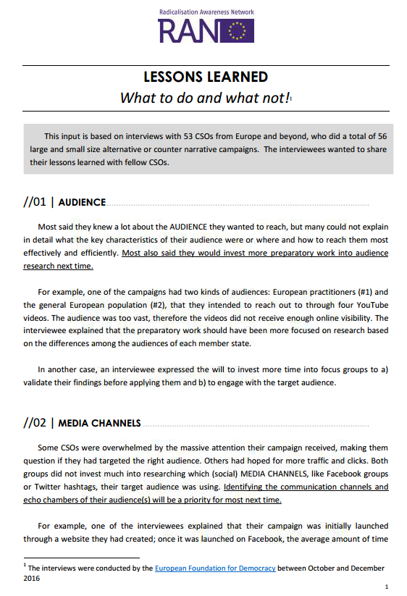
What to do and what not to do
Audience
Media Channels
Monitoring and evaluation
Call-to-action
Intervention
Notes:
See the Lessons Learned paper ‘What to do and what not’ by the European Foundation for Democracy.
Insights from previous campaigns, based on the 50+ interviews EFD has done with NGOs plus review of relevant literature and evaluations.

Slide 41
Lunch break
12.30 – 13.30

Slide 42
What is your message?
G Goal
A Audience
Tell me your message…
M Message
M Messenger
…is it positive
or is it critical?
M Media
A Action
Notes:
Group discussion 10 mins
Alternative narratives
Positive story, reflects group identity
Inclusion oriented, empowering
Based upon the strength of your organisation or initiative
You do belong, you do fit in, you can succeed
Call-to-action
Counter narratives
Response or content created to counter extremism and hate speech online
Challenge violent extremism through theology, humour, expose hypocrisy and lies
Discredit, deconstruct, demystify violent extremism
Reference
RAN C & N workshop on jihadist propaganda & how to respond 3–4 October 2016

Slide 43
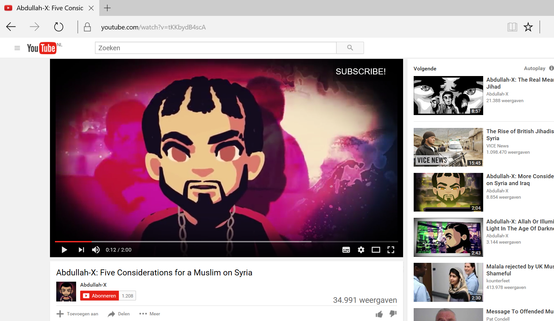
Notes:
Abdullah-X: Five Considerations for a Muslim on Syria
Example of a counter narrative: reasons not to go to Syria.
https://www.youtube.com/watch?v=tKKbydB4scA

Slide 44
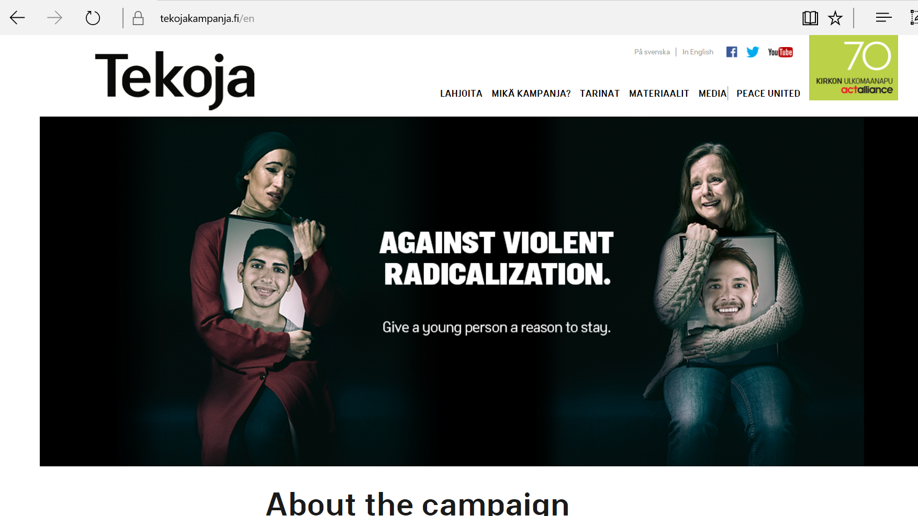
Notes:
Example of a counter narrative campaign from Finland
https://www.tekojakampanja.fi/en/
The theme for the 2015 Action-campaign by Finn Church Aid was young people and violent radicalisation. The objective of the campaign was to increase understanding of the factors driving people to join violent extremist groups, and present practical methods for preventing violent radicalisation both in Finland and in conflict areas

Slide 45
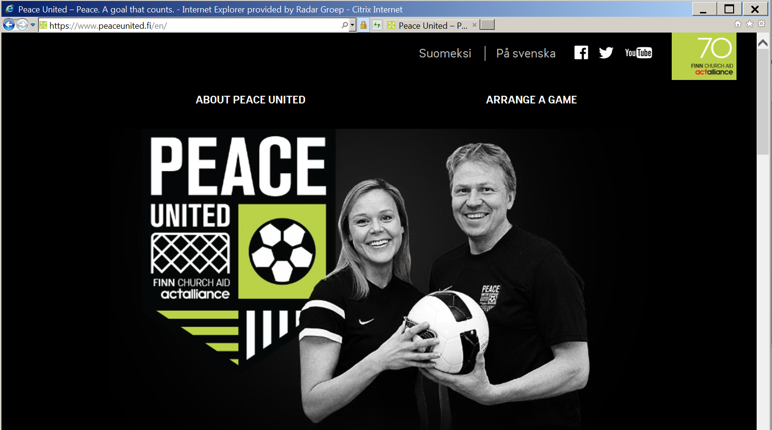
Notes:
Example of an alternative narrative campaign by Chruch of Finland: football unites.
https://www.peaceunited.fi/en/
The football campaign Peace United has both on- and offline elements: videos, board games, tests & quizzes etc.
Publications can be found here: https://www.peacemakersnetwork.org/our-work/thematic-expertise/

Slide 46
How to create attractive content
Keep thinking about your campaign goals!
  If your goal is to interact with your audience, organise content that is interesting enough to spark dialogue
  If you want your audience to take action, how are you going to persuade them?
  If you want them to learn something, do not act as a teacher
Deliver content with added value, be fun & interesting!

Slide 47
Who is the messenger?
G Goal
A Audience
Plenary discussion
The message and the messenger in
the following examples …
… are they credible, consistent,
compelling, connected?
M Message
M Messenger
M Media
A Action

Slide 48
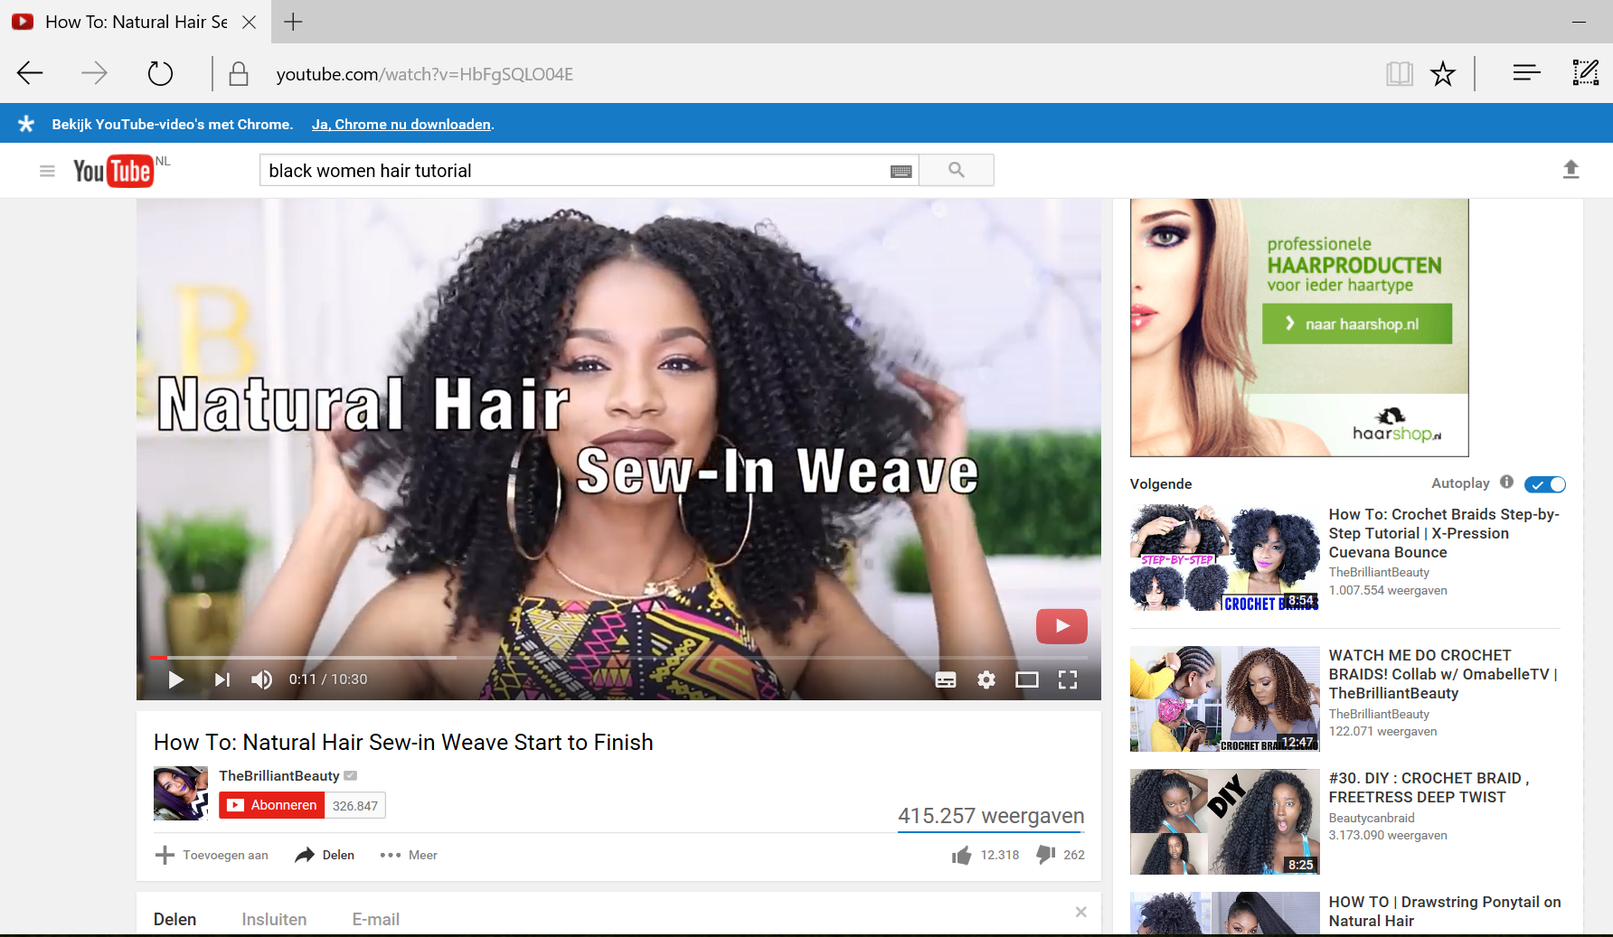
Example
Video van black hair
Notes:
Example of a credible messenger:
On YouTube, you will find many How-To videos with instructions by black women on how to do your hair. Including e.g. how to sew extensions into natural hair, how to make curls in black hair, or how to customise lace frontal wigs. These videos are placed on YouTube by women who noticed that these types of beauty programmes were not broadcasted by regular television. The interest from black women in beauty tips was ignored.
Therefore, people from the “target audience” started to make this type of tutorial themselves. It makes them very credible.
https://youtu.be/HbFgSQLO04E

Slide 49
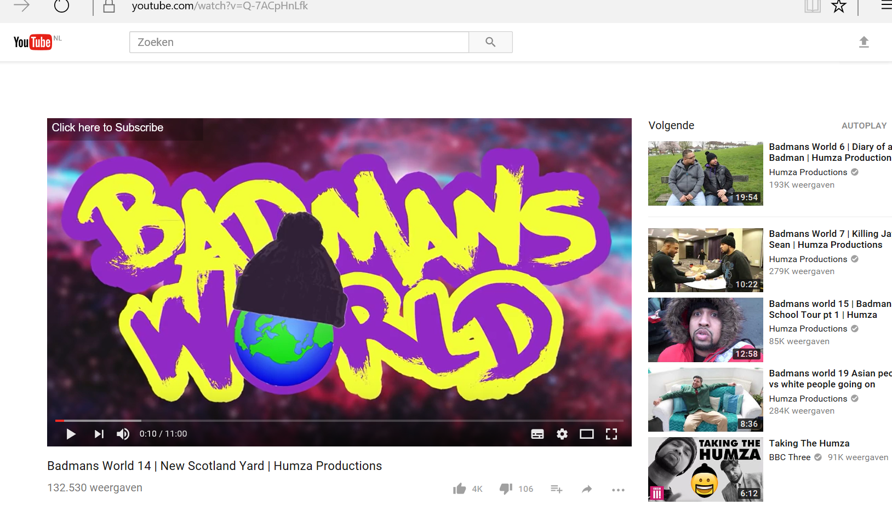
Notes:
Example of credible voice
Humza Arshad: Badmans World 14 | New Scotland Yard | Humza Productions
https://www.youtube.com/watch?v=Q-7ACpHnLfk

Slide 50
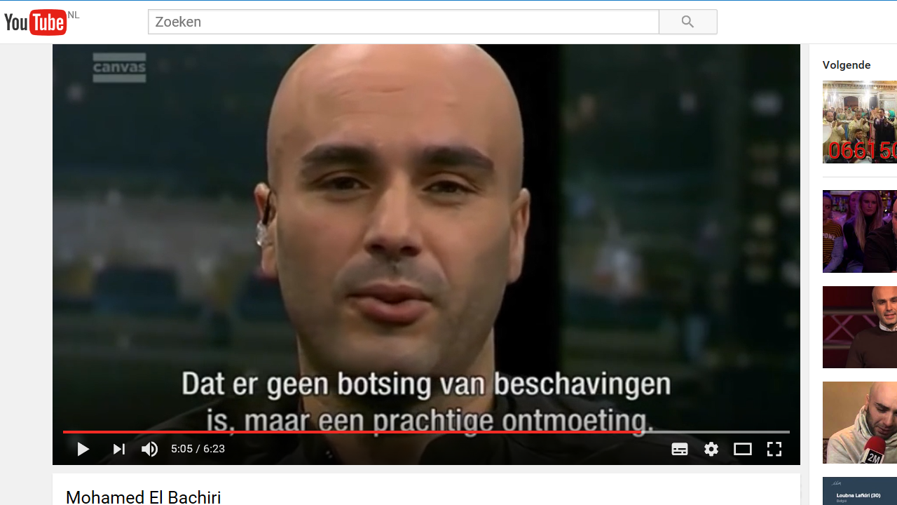
Notes:
Mohamed El Bachiri
Jihad of love - also a book
https://t.co/KIn4Wv78ZI

Slide 51
Credibility is key to success
Often, the messenger is more successful when (s)he
is credible in the eyes of the target audience
Often, but not always, credibility is enhanced when the messenger
is both compelling as well as connected
uses both facts & figures as well as emotions & beliefs
Notes:
Note to trainer
Messenger can be a person or a credible voice in another way e.g. tv or radio station or website
Important is that the messenger and his/her message “fit”. A scientist or politician can be a credible voice when we are talking about scientific facts or political discourse.

Slide 52


Head
Heart
Belly
Messenger
Audience
Notes:
Exercise: Reflection in pairs
Who are the messengers of your narrative?
How do they relate to your target audience?
Distribute drawing paper with image of messenger.

Slide 53
Halftime!
G Goal
A Audience
We have the first building bricks for your Campaign Strategy ready!
M Message
M Messenger
M Media
A Action
Notes:
Explanation: this slide introduces the next slides where we will explain the use of campaigning templates
Now you know how to define your goal, your target audience and your message, we have the first building bricks that we can use to build a Campaigning Plan.
Introduction to the three templates by EFD.
These are simple instruments for NGOs/CSOs willing to start a C/A Campaign.
Including Practical campaign tips and steps for NGOs as well as hands-on tips for NGOs with limited resources and little experience in the field of communication.
Material includes references to existing more in-depth learning material/handbooks

Slide 54
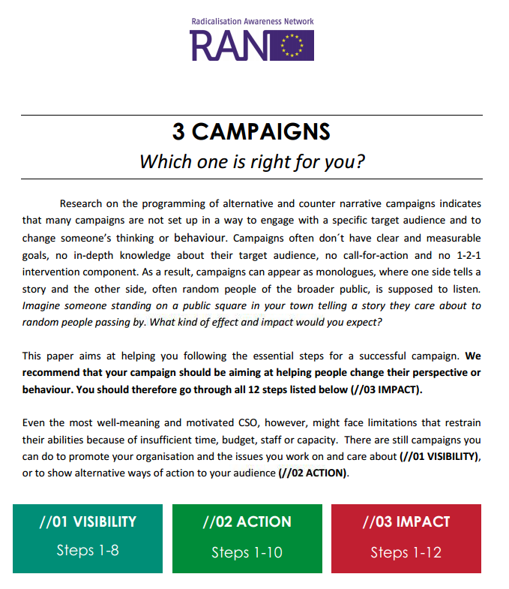
Useful tool: campaign templates
1. Visibility
Take a good look at our work!
2. Action
Here is what you can do!
3. Impact
Engage with them and change their mind
Notes:
Introduction to paper 3 Campaigns – which one is right for you?
This paper offers a three-stage template for a successful C/A narrative campaign.
The paper was prepared by the European Foundation of Democracy, based on experience with campaigning
The three stages cover in sum 12 steps. Following these steps is ideal preparation for your own campaign.
Visibility
Define your goal: make it clear, realistic and measurable
Know your audience: invest time in finding and understanding your audience
Pick a target: narrow down you target audience as much as possible
Monitor and evaluate: set up social media metrics and tools
Choose your media: only use media your audience uses
Tailor your message: develop messages your audience will care about
Find a messenger: select a messenger credible for the audience
Stay safe: prepare for verbal abuse and threats
Action
Listen to the feedback: are you reaching the right people?
Call-for-action: what should the audience do now? How can they help?
Impact
1-2-1 Intervention: engage individually, have a conversation, make them (re)think or empower them
Keep on Learning: invest in an in-depth evaluation so that you can be even better next time

Slide 55
How online works
14.30 – 16.15

Slide 56
From strategy to operation
G Goal
A Audience
In this section
How online works
Tools, manuals & tutorials
Tips & tricks
M Message
M Messenger
M Media
A Action

Slide 57



What social media platforms …
... do you know? (and which not)
  … do you use, personally and professionally?
  … does your target audience use?
What gaps, chances and threats do you see?
Notes:
What apps are on your phone? And what apps are on the phone of your children?
Exchange of experience. Can be done in pairs, small groups or the plenary.
List names of platforms; divide into categories: used by you, used by your target audience.
Make use of the image on the following sheet.
Discuss the differences between the way participants make use of social media and the way their target audience does this.
Reflect upon the meaning of these differences in the plenary.
20 mins

Slide 58
Social media
used by your target audience
Social media
you use
Do you meet here?
Notes:
Exchange of experience. Can be done in pairs, small groups or the plenary.
List names of platforms; divide into categories: used by you, used by your target audience.
Make use of the image on the following sheet.
Discuss the differences between the way participants make use of social media and the way their target audience does this.
Reflect upon the meaning of these differences.

Slide 59
Reaching people with your message
Mobilise your network
Extend your reach
Get fans and supporters
Notes:
Mobilise your network
Bloggers and vloggers will link to your articles
Facebook users will ‘like’ and share links to your articles
Twitter users will link to your articles and ‘retweet’ others who do so
People will email links to your articles to their friends
Extending your reach
Start with people you know, personally and as an organisation
Share links to articles on your website, add a personal message to your Facebook fans
Use Facebook ads in order to reach beyond your circle of friends
Get fans and supporters
Redirect to your Facebook page in other media
Fan-box on your website
Ask your fans questions, engage & be positive

Slide 60
Online = dynamic dialogue
Continuous ongoing stream of messages (not 1-time marketing efforts)
Dialogue (instead of monologue)
Open for response
Network communication (instead of sender > receiver)
Personal, individual (instead of mass, anonymous)
At the dark side: echo chamber and bubble effect (instead of confrontation with the unknown)
Notes:
Group discussion
Invite participants to list the specific characteristics of online communication.
1 participant can list shared insights on a flip chart.
Ask for experiences and real life examples
Online campaigning actually means entering into a dynamic dialogue:
You can communicate directly to an interested audience
You enter a conversation, with journalists, websites, bloggers and organisations linking to each other’s stories
You have the continuous possibility to adapt or adjust your message and campaign to external developments, e.g. comments, likes, shares and/or to political/social events/actions undertaken by others
1 condition: non-stop monitoring and measuring of your impact
Note: often, you are not alone in the control room
Note: echo chamber and bubble effect are both a danger (from the viewpoint of threat of radicalisation) as well as an opportunity (from the viewpoint of offering C/A Narratives at the right moment). If you happen to know the content, language, vocabulary, tone-of-voice and image/visuals style of the extremist organisations/social media that are targeting your target audience, then
you can compose messages in a similar way, and thus be found more easily by search engines (Search Engine Optimalisation techniques - SEO)
You can focus your online efforts e.g. by defining precisely defined audiences for Facebook ads

Slide 61

Echo chamber or bubble effects
Notes:
In news media, an echo chamber is a metaphorical description of a situation in which information, ideas, or beliefs are amplified or reinforced by communication and repetition inside a defined system. Inside a figurative echo chamber, official sources often go unquestioned and different or competing views are censored, disallowed, or otherwise underrepresented.
The echo chamber effect that occurs online is due to a harmonious group of people amalgamating and developing tunnel vision. Participants in online communities may find their own opinions constantly echoed back to them, which reinforces their individual belief systems.
This is happening because the Internet has provided access to a wide range of readily available information and people are increasingly receiving their news online through untraditional sources.
Companies like Facebook, Google, and Twitter, have established personalisation algorithms that they use to direct specific information to individuals’ online newsfeeds.
This method of curating content has replaced the function of the traditional news editor.
From the viewpoint of offering C/A Narratives at the right moment, understanding the echo chamber effect can offer opportunities to engage in dialogue with your target audience.
If you happen to know the contents, language, vocabulary, tone-of-voice and image/visuals style of the extremist organisations/social media that are present in the echo chamber environment (actors in the bubble), then
you can compose messages in a similar way, and thus be found more easily by search engines (Search Engine Optimalisation techniques - SEO)
You can focus your online efforts e.g. by defining precisely defined audiences for Facebook ads

Slide 62
How will you affect behaviour change?
Make It Easy
Make it Social
Make it Cool
Make it Time-Sensitive
Notes:
Make It Easy
Default to the easy option
Easy call to action – only ask 1 thing
Make it Social
Show that it’s what everyone else is doing
Use the power of networks - collective action, and mutual support
Get people to make a public commitment
Make it Cool
Fame (aspiration)
Scarcity
Rewards
Risk / Reward balance
Branded or not?
Make it Time-Sensitive
Timely interventions
Cost vs benefit
Prompt
Source: Alicia Kearns

Slide 63
Exercise
Split up into groups of 3 persons
Search the internet for a good example of Dynamic Dialogue
Discuss the working principles in this example
15 mins

Slide 64


Three big social media platforms
Notes:
Start every slide by asking participants whether they use these platforms, and how
Explanation
The CSEP training programme has been developed in close collaboration with TW, FB and YT.
These are the biggest social media platforms at global scale.
Often, it is smart to choose one of these as your home-platform. That is, the place where you start building your online community and/or online campaign.
Each platform has several advantages as well as drawbacks regarding online communication with selected target groups.
And it is easy to improve your performance on each platform when you know about some basic Dos and Don’ts. In the next 2 hours, we will share with you many tips & tricks and introduce basic techniques, tools and tutorials that can help you in the development and execution of your Campaign.

Slide 65

“70% of the teens and millenials believe that Youtube creators shape culture and their life”
Format
You don’t have to have television quality
Youtube makes moviemaking and watching more accessible than ever before
Notes:
Question to participants: to how many youtube channels are you subscribed? What kind of movies do you watch most?
YouTube is the 2nd biggest social media platform in the world. So this is where many people go when they start searching for extremist content.
If you are an educational institute: how do you find a balance between being funny and educational, serious? Main part of YouTube content is educational. E.g. series “Animate” – How to help every child fulfill their potential?
When you are working on a strategy that aims at communicating with these groups at risk, it might be useful to be present on the YouTube platform too.
With well developed content, you might succeed in entering the Echo Chamber of people who belong to your target audience.
It is NOT difficult to make a YouTube movie. Everyone can do it with his or her smartphone or tablet.
There are various apps available for recording, editing and styling your productions.
Most things can be done just on your mobile device.
Simplicity and a certain degree of a amateurism in the production will even enhance the credibility of your movie.
It is not a problem that viewers see that you are not a professional film-maker; it is an advantage.
It stresses the authenticity of your message, and makes it much more personal.
Being “personal” is key to success on YouTube. You are entering a conversation with people who are interested in you and who expect you to show interest in them – by showing yourself.

Slide 66
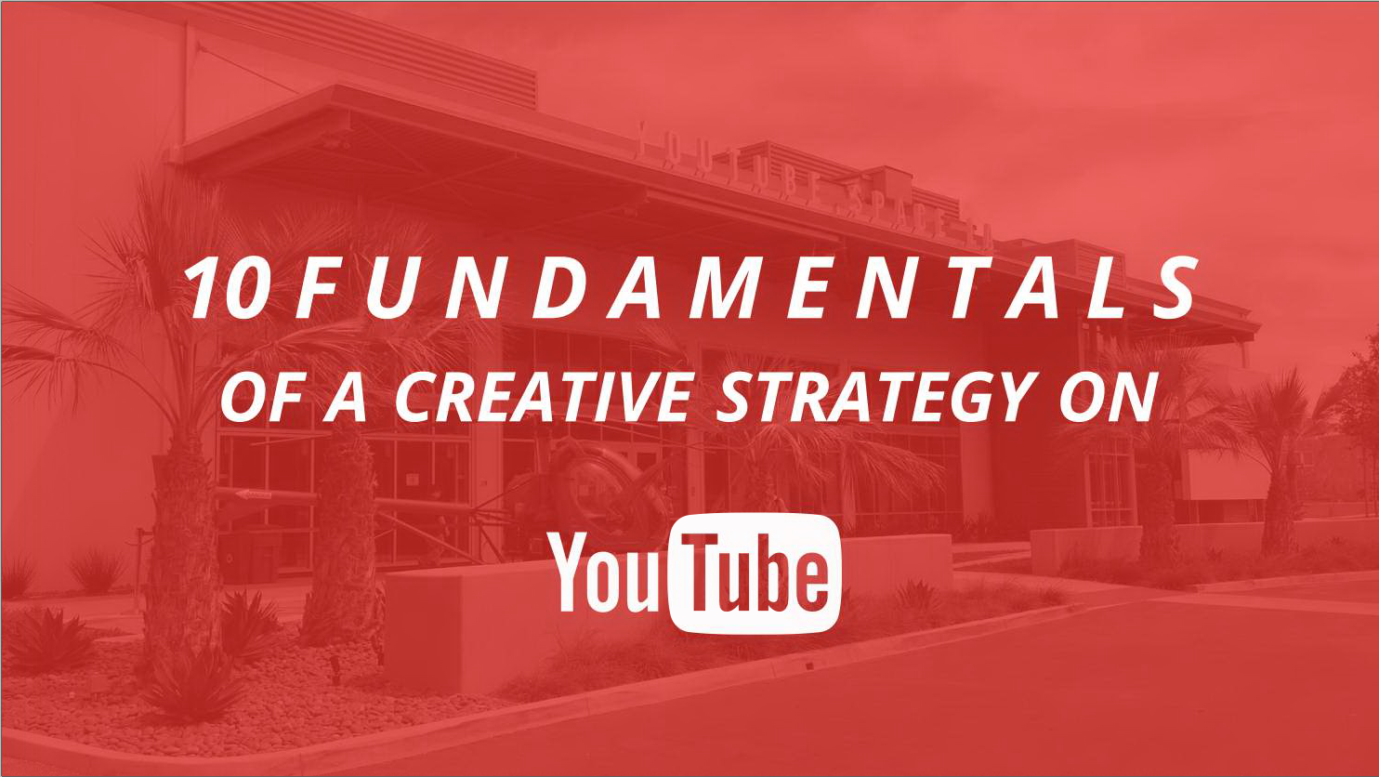
Notes:
We just learned that the format of YouTube is very easy to handle.
How to build a content strategy on YouTube?
YouTube developed 10 fundamentals that might help you to make productions that live up to the desired outcome.
Source: Bit.ly/10fundamentals

Slide 67
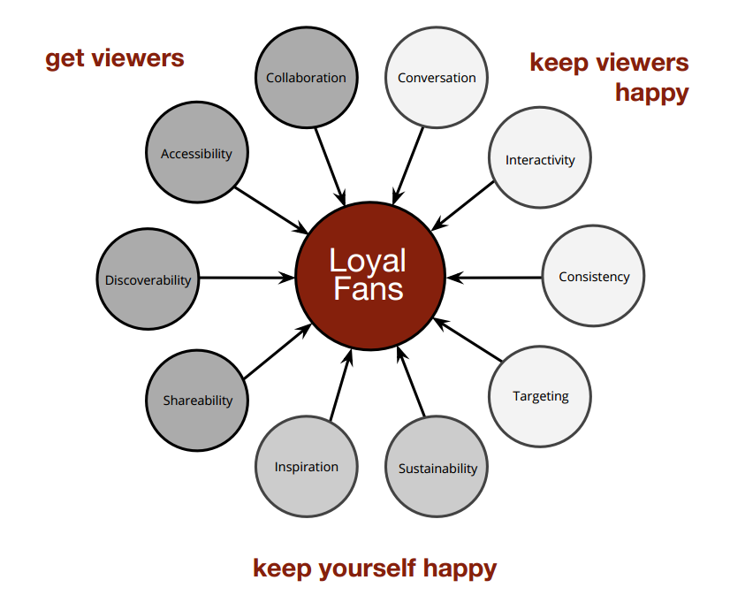
10 Fundamentals
Bit.ly/10fundamentals

Slide 68
5 out of 10
Conversation
Consistency
Sustainability
Discoverability
Collaboration
Notes:
Conversation
Speak directly to your audience
Be approachable, genuine, authentic, not preachy
Consistency
Are there strong recurring elements to your ideas?
Schedule > very hard e.g. tv programmes > Don’t, better try:
Personality > franchesca ramsey
Format > tedex: the 10 commandments, chicken
Voice > perspective or point of view: always a red t-shirt
e.g. Blacknerdcomedy
Sustainability
If the audience loves it, can you make more?
The fine bros: if we can’t do three videos a day, we’ll skip the idea
Project invisible people about homeless people
Discoverability
Will your videos be found through a search?
Think of titles and description
Trending <> evergreen
First three words need to match trends > google.com/trends/explore
E.g. Telfaz11 no woman no drive
Collaboration
Build a “guest chair” into your show.
Design the show in a way that makes it easy and logical to have guest stars.
Reach out to partners that fit. Find creators in your genre or niche with similar subscriber numbers.

Slide 69
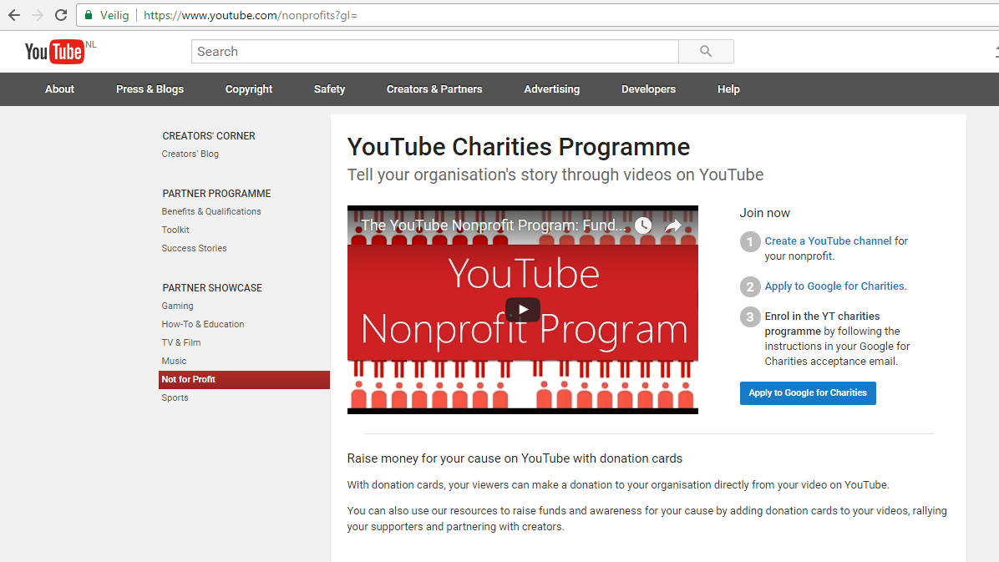
Notes:
https://www.youtube.com/watch?feature=player_embedded&v=YpKAtk5C0lM
https://www.youtube.com/nonprofits

Slide 70
“1 billion photos uploaded
to facebook daily”
Done is better than perfect
Notes:
Question to the participants: how many Friends do you have on Facebook? How many posts do you post daily? And how many Likes do you give daily to posts by your friends?
Explains the size and importance of Facebook on a global scale.
Inspires to approach the internet as a platform for inter-action and communication instead of sending information
Fail harder

Slide 71
What works on facebook?
Make your posts conversational
Informal, personal, and inviting response
Be authentic
Be visual
Be simple
Be timely
Notes:
More tips:
Less is more
Fewer counter speech posts have higher effects
More specific posts are better received – no more than 1-3 messages / day
Timely = adapting your message, post, visuals to actual events, occurrences, activities in your community, surroundings, the regular media
Divide organic audience from paid audience (see Facebook Ads)
Link Facebook to Instagram

Slide 72
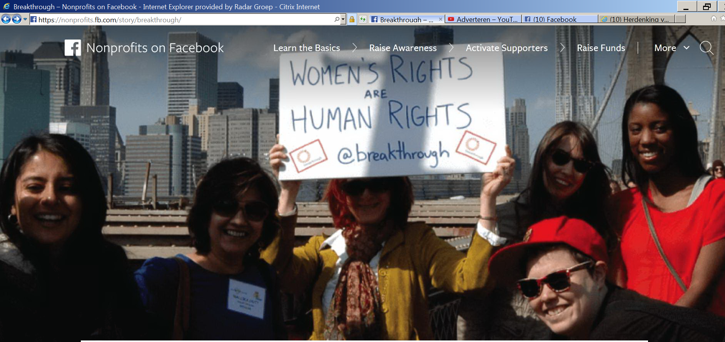
Organic audience vs paid audience
Notes:
Divide organic audience from paid audience > Facebook has several tools that can help you reach new people
1. Facebook Ads for non-profits: https://nonprofits.fb.com/topic/ads/
2. The Facebook SMB page shows various tools that can be used to help you help your cause: https://www.facebook.com/blueprint?attachment_canonical_url=https%3A%2F%2Fwww.facebook.com%2Fblueprint
Arguments in favour of paid ads
Find new supporters by reaching outside your existing community
Reach out to people who are similar to your existing supporters
Make sure more of your audience sees an important post
Send calls to action to people with particular demographics, interests or behaviors
Drive specific behaviours, like visiting your website or signing up for your email list
Facebook Ads can help you reach new people on Facebook who may be interested in your organisation.
Facebook Ads are paid placements of content on Facebook. Ads can appear directly in News Feed or in the right hand column.
Ads are particularly useful if you want to reach new people on Facebook or show your message to specific audiences.
You can run ads on any budget, starting with as little as €5.
How Can I Use Ads For My Nonprofit
Find new supporters by reaching outside your existing community
Reach out to people who are similar to your existing supporters
Make sure more of your audience sees an important post
Send calls to action to people with particular demographics, interests or behaviours
Drive specific behaviours, like visiting your website or signing up for your e-mail list
How Do I Create an Ad?
The first thing you need to do is choose an objective. An objective is what you want to accomplish. When you choose an objective, this creates a campaign which is the first level of the ad structure.
Second, you should define your audience, select where your ads will appear and choose your budget and schedule. Choose from e.g.
Demographics. Reach people by age, gender, education and more.
Interests. Reach people based on their interests, hobbies and Pages they like on Facebook.
Behaviours. Find people based on their purchase behaviours, device usage and other activities.
Connections. Reach people or their friends based on Pages they like.
Third, you decide on the content people will see.

Slide 73
40% are ‘listeners’
Credibility comes over time. Be honest and constistent

Slide 74

What works on Twitter?
Factual content. Personal Language
Think about what interests your audience
Everyday content
Tip: offer Q & A sessions
Don’t wait, be in the moment
It is both about your target audience as well as your target moments
Notes:
Question to participants: send out at tweet at – and check retweets in next break
“Extremists online shout loudly but are few - Civil society is speaking up > #RANCSEP #EUINTERNETFORUM
Handbook > http://esmeefairbairn.org.uk/
Use the power of positivity.
Most important is to be there at the right moment. React directly to events that occur or to events that you organise yourself.
Contrary to Facebook, there are no limits to the number of posts on Twitter, because of the speed at which the timeline is renewed.
This also offers the opportunity to recycle tweets as well as your posts from other platforms.
And you can experiment by placing a tweet and checking the response.
Q & A sessions: e.g. for the next hour, we are online and we’ll be happy to take your questions
Example of personal language: Met office and Innocent Drinks
Example of the moment: tweet by Britain Tourist office

Slide 75
Tea break
15.30 – 15.45

Slide 76
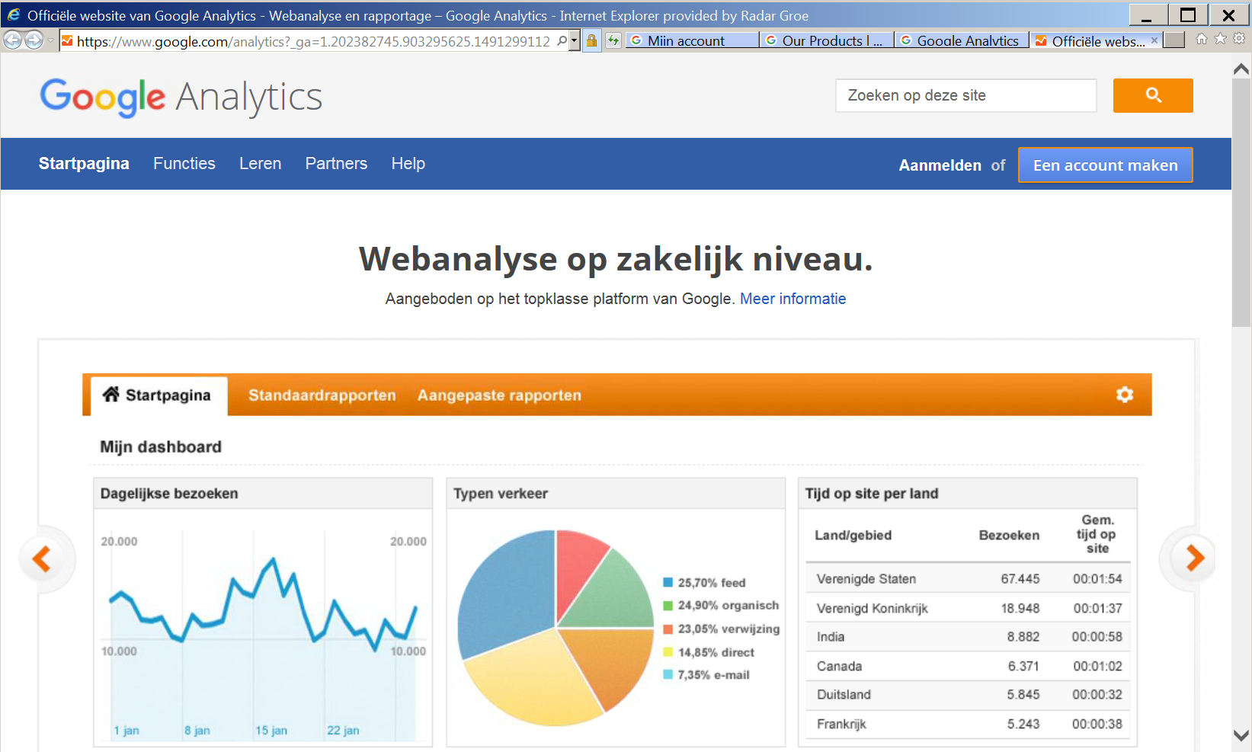
Are you on the right track?
Notes:
Analytics
Are you on the right track? Are you being read? How are we doing in online space? Who knows about my page, tweets, ads?
Each platform has it own possibilities to see how many followers, likes, posts et cetera are generated by your online efforts.
Note: these tools are primarily designed to serve commercial clients who need insights into revenues and target audiences for commercial product/services.
Exercise, in pairs: Find the Analytics page of Google, Facebook and Twitter

Slide 77

Hate speech: what to do?
Respond
Report
Ignore
Hide
Block, delete
Notes:
Explanation
Respond – requires good preparation + assessment in terms of the goal of your campaign: will responding contribute to realising your aims? Is the sender of the message a member of your target audience or its surroundings?
Report – Both Youtube and Twitter as well as Facebook have an active policy regarding hate speech and violent extremist/terrorist content (community standards), see below. In addition, national law applies and in relevant cases, contact the police.
Ignore – Doing nothing will make the sender’s contribution irrelevant
Hide – Option that allows you to make the post invisible for others with the exception of yourself and the one who posted. He/she will continue thinking his contribution is still seen by others.
Block, delete – you will make it impossible for the person to leave future posts on your page.
Reporting – how to? Refer to applicable pages on all platforms:
Twitter >
Facebook >
Youtube >
Often, the machines behind the platforms recognise hate speech/terrorist content automatically.
Terrorist content or hate speech is also flagged by users.
All platforms have reporting tools.
Example: on Facebook, 50% of terrorist content is flagged by users. 50% of this reported content is reviewed by staff. The rest is checked automatically.
However, on all platforms one sees a grey area that is open for discussion.

Slide 78

Counter Speech Information Pack
Online Civil Courage Initiative OCCI
EN, GE, FR
Notes:
http://www.strategicdialogue.org/wp-content/uploads/2016/06/OCCI-Counterspeech-Information-Pack-English.pdf

Slide 79
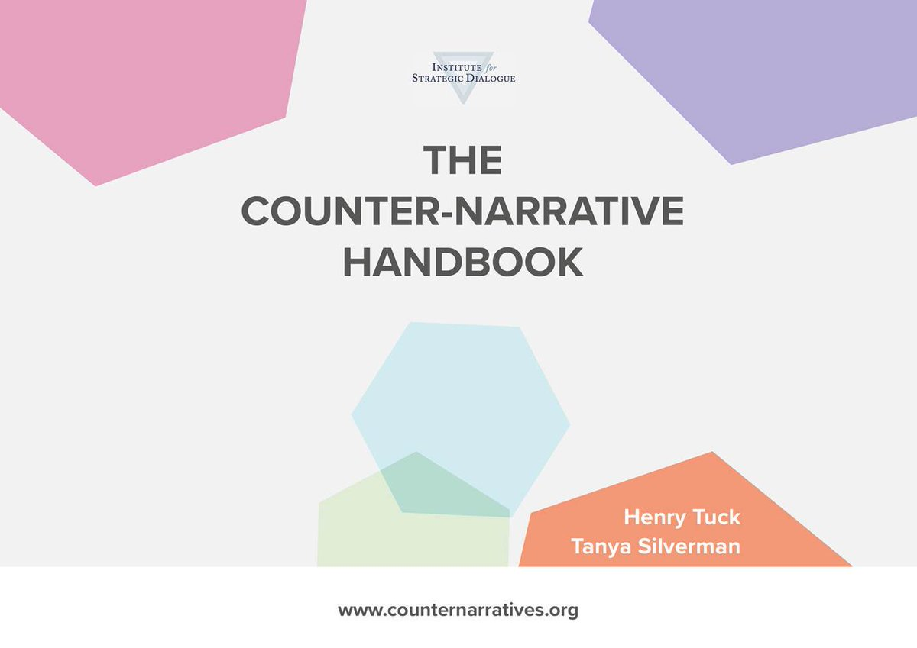
Contents
Planning a Campaign
Creating Content
Running a Campaign
Online Advertising
Engaging Audiences
Evaluating Campaigns
Toolbox & Resources
Institute of Strategic Dialogue ISD, 2016
http://www.strategicdialogue.org/wp-content/uploads/2016/06/Counter-narrative-Handbook_1.pdf
Notes:
Institute of Strategic Dialogue ISD, 2016
http://www.strategicdialogue.org/wp-content/uploads/2016/06/Counter-narrative-Handbook_1.pdf

Slide 80
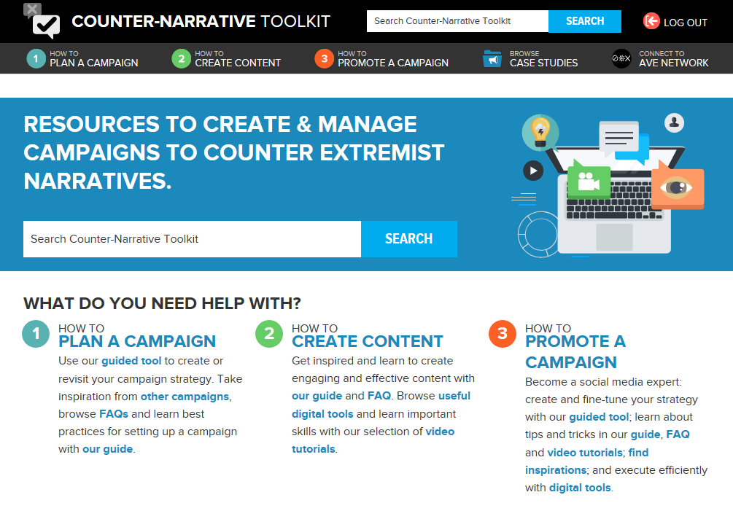
Notes:
www.counternarratives.org
This is an online toolkit to help people develop their own counter-speech/counter or alternative narratives
Freely available guide
Basic guide for those with little to no previous experience of counter-narrative campaigning
Funded by Facebook, inspired by a pilot project with Jigsaw (formerly Google Ideas)
Here is a link to the Facebook SMB page which shows people the various tools they can use on Facebook to help their cause.
https://www.facebook.com/blueprint?attachment_canonical_url=https%3A%2F%2Fwww.facebook.com%2Fblueprint
This is a 10-page mini handbook about online engagement with counter-speech through the Facebook Online Civil Courage Initiative (available in English, French and German):
http://www.strategicdialogue.org/wp-content/uploads/2016/06/OCCI-Counterspeech-Information-Pack-English.pdf
About Counter-Narrative Monitoring and evaluation
http://www.strategicdialogue.org/wp-content/uploads/2016/12/CN-Monitoring-and-Evaluation-Handbook.pdf

Slide 81
Exercise
In small groups ( 3 – 4 persons)
Search for 1 or more of the presented tools, tutorials, manuals
Browse the material
Discuss its applicability for your campaign
If time remains, we will discuss findings in the plenary
15 mins
Notes:
See next slide for overview of links

Slide 82
Tools, tutorials and manuals
Counter speech information pack
http://www.strategicdialogue.org/wp-content/uploads/2016/06/OCCI-Counterspeech-Information-Pack-English.pdf
Counter narrative handbook
http://www.strategicdialogue.org/wp-content/uploads/2016/06/Counter-narrative-Handbook_1.pdf
www.counternarratives.org
http://www.strategicdialogue.org/wp-content/uploads/2016/06/OCCI-Counterspeech-Information-Pack-English.pdf (10 pager)
Campaigning on Twitter Handbook
http://esmeefairbairn.org.uk/
Facebook SMB
https://www.facebook.com/blueprint?attachment_canonical_url=https%3A%2F%2Fwww.facebook.com%2Fblueprint
Facebook Ads for non-profits
https://nonprofits.fb.com/topic/ads/
Youtube non-profit programme
https://www.youtube.com/nonprofits
https://www.youtube.com/watch?feature=player_embedded&v=YpKAtk5C0lM
Youtube 10 Fundaments
http://Bit.ly/10fundamentals
Notes:
This list of links to tools manuals and tutorials will be sent in Word format to all participants.

Slide 83
Capacity building & wrap up
16.15 – 17.00

Slide 84
Capacity building
G Goal
A Audience
Wrap up
Where are we now?
Time to mingle and start dating
M Message
M Messenger
M Media
A Action

Slide 85
Linking online-offline engagement
Every campaign hovers around a Call to Action
Are you prepared?
Desire response
Critical or negative response
Verbal/physical threats/violence
Notes:
Every campaign is centered around a Call to Action. You want people to start (or to stop) doing something.
If someone is very angry/upset about Sunnis being killed by Shia in Syria, or fearful of the influx of refugees, a simple “you are wrong, change your mind” will not do the trick.
The call-to-action should aim at channeling that anger/emotion to something productive and to show a concrete alternative action for the individuals you are trying to reach.
Developing those concrete actions is not easy but important for your campaign to have impact.
Often, engagement starts online, e.g. with retweeting or liking a post on Facebook.
Sometimes, it evolves into offline participation (activities by your organisation or offline contacts).
Next to the Action you call for, you might face responses that you did not expect or did not want. Every online effort has offline consequences and it is very important to take this into consideration while designing your campaig strategy, for at least 3 reasons:
Desired response
People might actually respond positively to your Call-to-action and become willing to do things “in the real world”, like participating as a volunteer in your organisation, or requesting support from your organisation, or asking for further information.
Is your organisation prepared to answer these kinds of responses?
Is somebody sitting by the telephone?
Is somebody answering e-mails or posts on Facebook?
Critical or negative response
Opponents of various sorts might react to your online efforts by criticising your posts, abusing your hashtags, stating critical (false) information about your organisation on the internet et cetera.
How do you deal with this type of response?
Will you answer comments, or will you ignore them?
Are your facts & figures checked and correct? Are you able to counter “alternative facts”?
Will you start a discussion or will you block a person?
Do you have different approaches towards your target audience, its surroundings and third parties that do not play a role in your campaigning objectives?
Verbal and/or physical threats/violence
In some cases, your online presence and activity might provoke verbal and/or physical threats and/or violent reactions.
Can you make a risk assessment before you start your campaign?
How do you prepare your workers and volunteers?
Are you and your colleagues traceable via the internet? What e-mail addresses do you use?
What names are detectable behind your organisation’s Facebook or Twitter account?
Do you know how to report hate speech?

Slide 86
What are your campaigning qualities?
Internal You can influence these things more easily | Strengths | Weaknesses
External You cannot influence these factors easily | Opportunities | Threats
Notes:
SWOT (Strengths, Weaknesses, Opportunities, Threats) test each Action Plan
Towards the end of the day you could have a Show and Tell where trainees share back their action plans. The audience and training experts have their SWOT hats on, commenting on the strengths and weaknesses of the plan, the opportunities presented, e.g. upcoming topical event to tap into (e.g. religious holidays), funding pots to utilise, specific free online tools to utilise, relationships with the private sector to utilise. Threats - e.g. finding meaningful engagement, sustaining financial investment in the work, getting other CSO staff on board.

Slide 87
Reflection
Reflecting upon today’s programme…
What inspired you?
What is already going well?
What is needed/left to do?
Who do you need realise this?
Notes:
Reflect in pairs on the quality of your organisation in relation to your CN narrative.
What new insights did you obtain today?
What will you do with this new expertise?
Are you equipped to start developing an effective online campaign?
What do you need more of?
Who will be able to help you?
You can use a simple SWOT analysis in order to analyse what external expertise can be useful for your organisation.
This is the starting point for a search for potential partners. You can think of both other CSOs as well as e.g. marketing agencies.

Slide 88
Partnerships
Speed date!
Search the room for potential partners
Make working agreements for further collaboration
Share results in the plenary
20 mins

Slide 89
Have a safe trip home
Radicalisation Awareness Network
Wim Klei – w.klei@radaradvies.nl +31 6 4229 7277
Evaluation
Please fill in the evaluation form that will be sent to you via e-mail
Thank you

